Slide 1

UK Gender Pay Gap Analysis
2021-22
Prepared by : Priyanka Bhatnagar
28/07/2023

Slide 2
Spread of Pay gaps across reporting companies
Notes:
Mean % difference between male and female hourly pay (negative = women's mean hourly pay is higher)

Slide 3
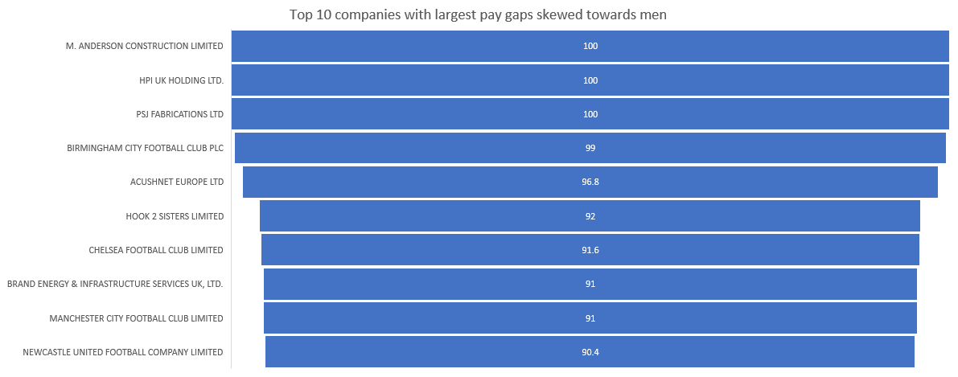
Top 10 companies with largest pay gaps skewed towards men
Notes:
Mean % difference between male and female hourly pay (negative = women's mean hourly pay is higher)

Slide 4
Top 10 companies with largest pay gaps skewed towards men
Avg hourly pay gap Mean % difference between male and female hourly pay (negative = women's mean hourly pay is higher)
Avg bonus pay gap Mean % difference between male and female bonus pay (negative = women's mean bonus pay is higher)
Avg male top quartile Percentage of males in the top hourly pay quarter

Slide 5
Average pay gap by employer size
Notes:
Percentage of males in the top hourly pay quarter is high
Percentage of females in the lower hourly pay quarter is high

Slide 6
Conclusion
The average across all companies in UK 13.63 %
Most companies with larger pay gaps in favour of men belong to football or construction industries
small size companies with 250-500 employees have a bigger pay gap considering male top quartile.
Notes:
Percentage of males in the top hourly pay quarter is high
Percentage of females in the lower hourly pay quarter is high

Slide 7
Limitations and Recommendations
Data Limitations
Average pay gap across regions, industries not readily available ut highly relevant to analysis.
other ways of calculating the gender pay gap not considered.
The gender pay gap is not the same as unequal pay.
Public and private sector information not available.
The siccodes need to be cleaned to better define the broad industry type.
data is biased since it doesn’t include gender diversity.
Data assumes everyone is at same level of seniority
Data collection improvements
Broader industry type data required by users to fill, instead of siccodes.
Relevant fields to be marked as mandatory which cannot be left blank.
Male vs. Female ratio to be included as a column- useful for measuring the overall ratio in an industry/ region/ company.
Another gender category required to include gender diversity.
Providing standard templates in the form of excel sheets or templates that can be copied easily.
Including management level – lower, middle or senior.
Age of company in years
Including regions within states information
Notes:
Other ways of calc pay gap- temp workers or contract employees.
Unequal pay is giving women less than men for the same work, for example fewer women in senior or highly-paid roles or
more women in part-time jobs.

